Slide 1
Human Alterations to Climate

Slide 2
How have humans affected climate and climate patterns in recent years?
Learning objectives
Carbon cycle
Effects of increased CO₂ in the atmosphere
Emissions since the Industrial Revolution
Recent climate change trends
Human impact on climate patterns
To answer these questions, we will:
Apply knowledge of the greenhouse effect and carbon cycle to understand changes in atmospheric greenhouse gas concentrations
Determine the connection between CO₂ emissions and atmospheric CO₂ concentrations
Investigate trends in global warming and climate since the Industrial Revolution
Explore human and natural drivers of climate change

Slide 3
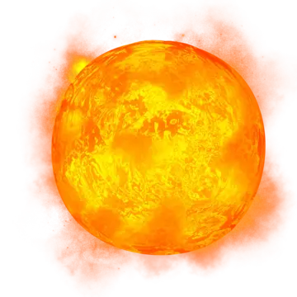


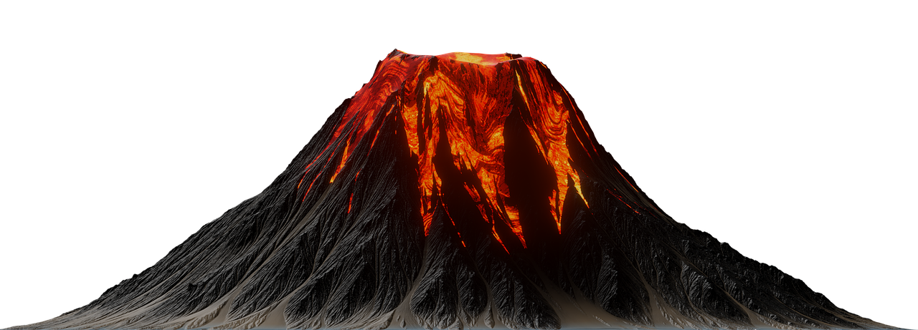





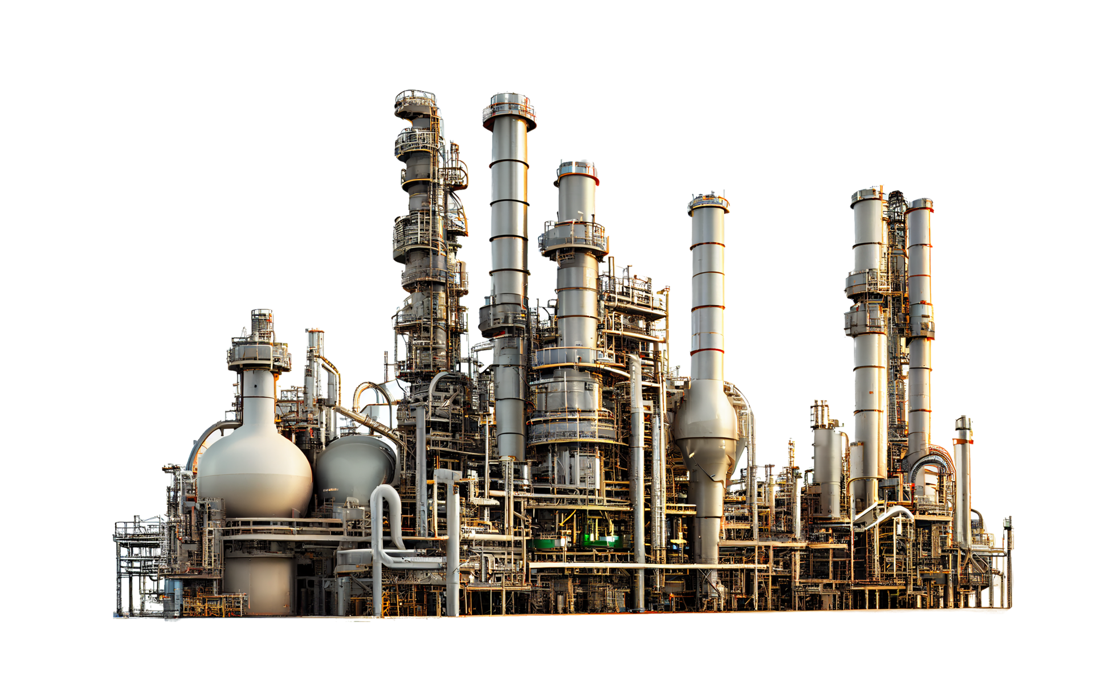

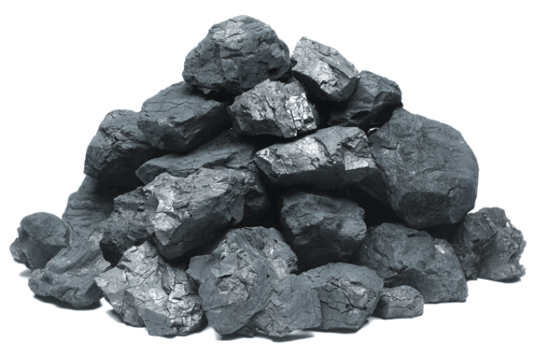
Atmosphere
Volcanism
Learning objectives
Carbon cycle
Effects of increased CO₂ in the atmosphere
Emissions since the Industrial Revolution
Recent climate change trends
Human impact on climate patterns
Rock
weathering
Oceanic gas
exchange
Combustion
Photosynthesis
Rocks and Soils
Oceans
Respiration,
decomposition,
& combustion
Fossil Fuels
Deposition
Living Things
Carbon Cycle
Notes:
*Note: This slide is animated!*
Carbon dioxide is the most abundant greenhouse gas in our atmosphere, however it cycles between different areas of our earth.
This is the carbon cycle. We have five carbon “sinks,” or places where carbon can be stored. These are the atmosphere, oceans, living things like plants, rocks and soils, and fossil fuels.
Carbon cycles in and out of these sinks in many different ways.
Carbon dissolves into the ocean and releases carbon to the atmosphere.
Photosynthesis allows plants to take in carbon and plant respiration, decomposition and combustion releases carbon from the biosphere into the into the atmosphere
Volcanic eruptions release carbon from the lithosphere into the atmosphere and rock weathering can store carbon in rocks, taking it from the atmosphere into the lithosphere
Living things can deposit carbon into soils and fossil carbon deposits, which were once living plants
Combusting or burning fossil fuels that are stored deep in our earth moves carbon back into the atmosphere

Slide 4
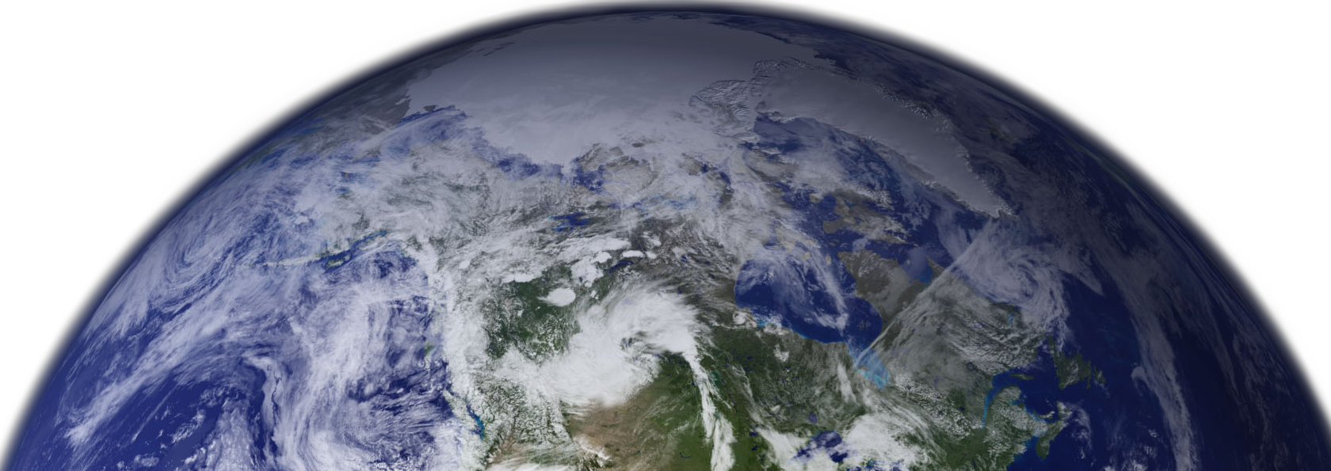
Effects of CO₂ in the atmosphere
Earth is too cold to support life without greenhouse gases
Earth warms with increased greenhouse gas concentrations
Learning objectives
Carbon cycle
Effects of increased CO2 in the atmosphere
Emissions since the Industrial Revolution
Recent climate change trends
Human impact on climate patterns
CO₂
CO₂
CO₂
CO₂
CO₂
CO₂
CO₂
CO₂
CO₂
CO₂
CO₂
CO₂
CO₂
CO₂
CO₂
CO₂
CO₂
CO₂
CO₂
CO₂
CO₂
CO₂
CO₂
CO₂
CO₂
CO₂
CO₂
CO₂
CO₂
CO₂
CO₂
Notes:
[Review] Without greenhouse gases to absorb and hold longwave radiation close to the earth’s surface, Earth would be too cold to support life as we know it (blue).
With a moderate amount of greenhouse gases (yellow), Earth can maintain a livable temperature.
With too much (red) greenhouse gases, Earth becomes too warm and results in climate change like we are seeing today.

Slide 5
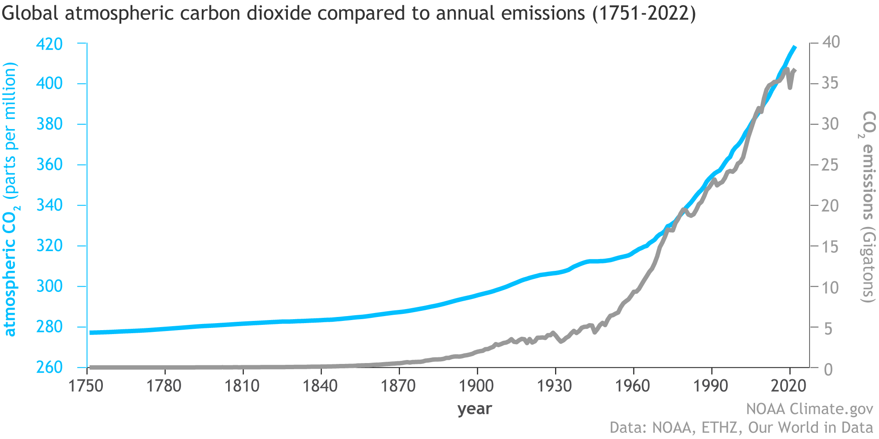
CO₂ since the Industrial Revolution
Learning objectives
Carbon cycle
Effects of increased CO₂ in the atmosphere
Emissions since the Industrial Revolution
Recent climate change trends
Human impact on climate patterns
Atmospheric CO₂ concentrations vs CO₂ emissions
Image copyright National Oceanic and Atmospheric Administration (NOAA). https://www.climate.gov/media/14596
Notes:
*Boxes are animated to highlight specific data trends*
CO2 concentrations have been increasing in our atmosphere since the Industrial Revolution, which began in about the mid-1800’s in the United States. Prior to this, you can see that atmospheric CO2 concentrations, which is the blue line, and CO2 emissions, which is the gray line, were relatively stable.
As we look into the start of the Industrial Revolution through to present day, we can see a steady increase in CO2 emissions, which correlates to the rise in atmospheric CO2 around the same time frame and amplitude.

Slide 6
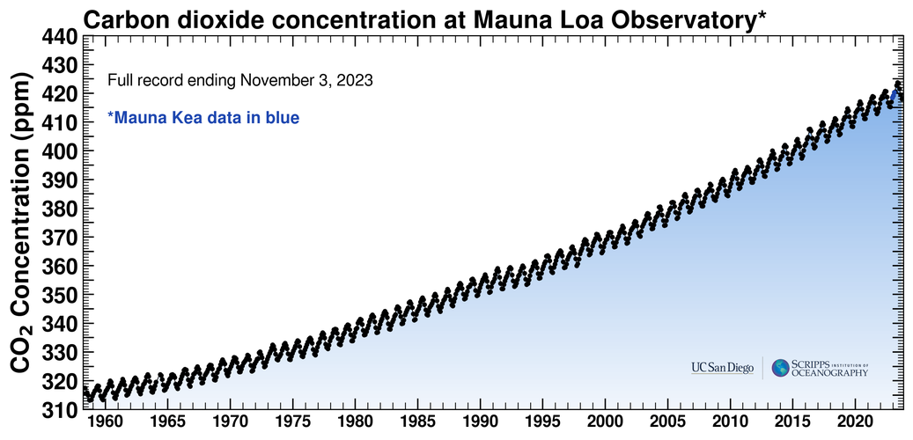
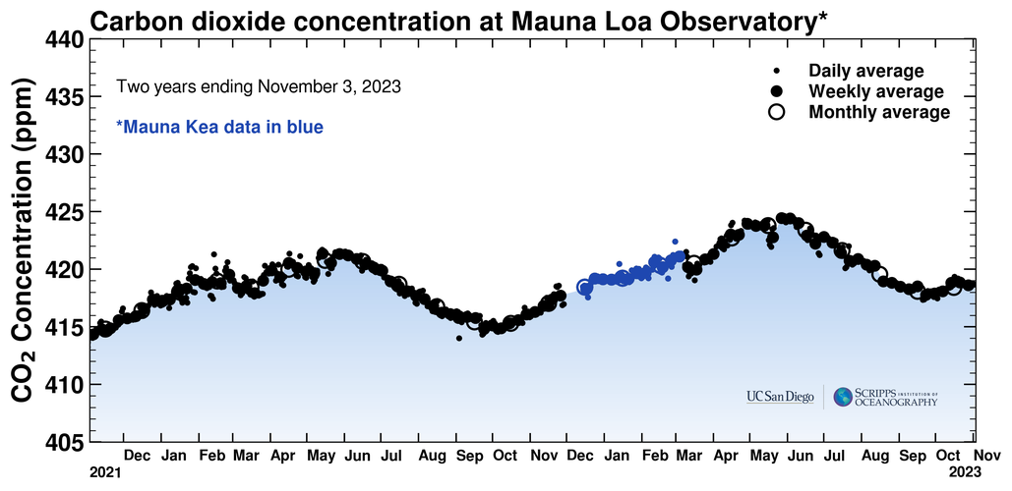
CO₂ concentrations since 1958
Learning objectives
Carbon cycle
Effects of increased CO₂ in the atmosphere
Emissions since the Industrial Revolution
Recent climate change trends
Human impact on climate patterns
Keeling Curve
Plant decay
Increase in CO₂
Plant growth
Decrease in CO₂
Image copyright Scripps Institution of Oceanography at UC San Diego. https://keelingcurve.ucsd.edu/
Notes:
*This slide is animated to more easily see the yearly patterns in CO2 concentrations*
Since 1958, atmospheric CO2 concentrations have been recorded daily at Mauna Loa Observatory, Hawaii.
When we look at the big picture, we can see that concentrations have steadily increased since 1958.
When we look closer at just a couple of years, we can see a zig zag pattern indicating an annual increase in CO2 concentrations that starts in the fall and an annual decrease in CO2 concentrations that starts in the spring. What you are seeing is the plant photosynthesis and decay part of the carbon cycle. Plants take in CO2 to grow during the spring and summer. They start to die, leaves fall, etc. and this will start to decay, releasing CO2 back into the atmosphere as the plants and plant litter decompose.
While we can see the annual effect that plants have on the atmosphere, CO2 concentrations have steadily increased throughout the years.

Slide 7
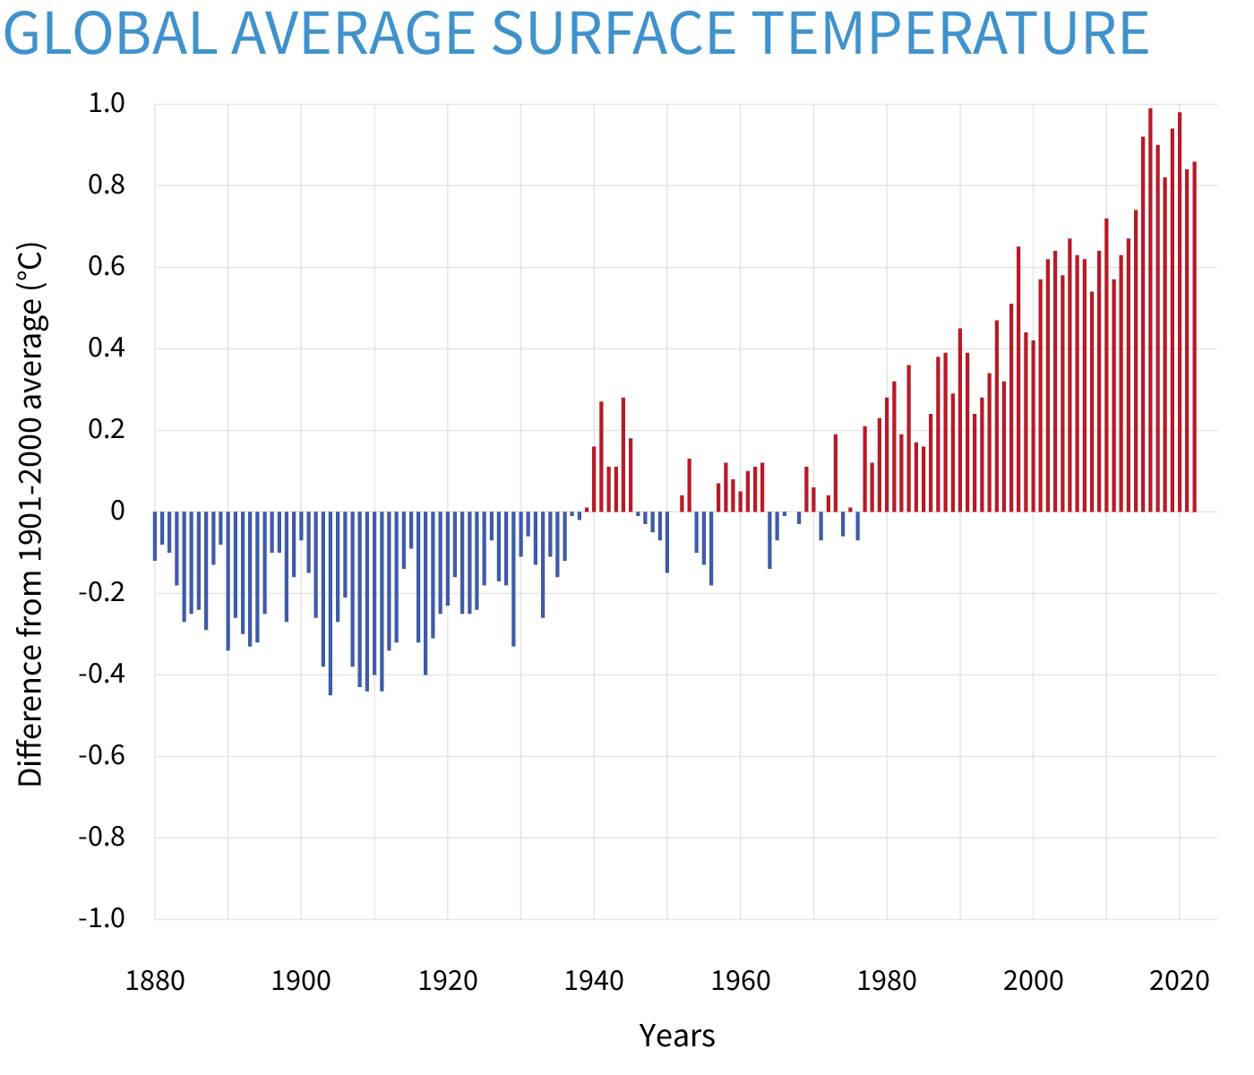
Recent trends in global warming
Learning objectives
Carbon cycle
Effects of increased CO₂ in the atmosphere
Emissions since the Industrial Revolution
Recent climate change trends
Human impact on climate patterns
Earth’s global temperature has risen about 2°F (1.1 °C) since 1880
1880:
56.5°F
(13.6°C)
1960:
57.0°F
(13.9°C)
2022:
58.7°F
(14.89°C)
Image copyright National Oceanic and Atmospheric Administration (NOAA). https://www.climate.gov/media/15021
Notes:
When we look at warming of the Earth as a whole, temperature has increased about 2°F since the Industrial Revolution.
The graph is showing annual temperature anomalies from the 1901-2000 global average baseline. Starting at the Industrial Revolution through about the 1940’s, temperatures were well below this average. After this time, there is a general increase in temperature anomalies, especially starting in the 1980’s where all annual average temperatures have been well above average.

Slide 8
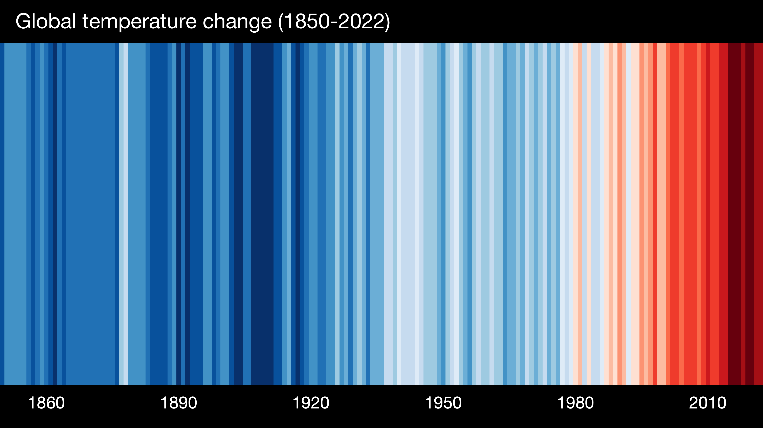
Recent trends in global warming
Learning objectives
Carbon cycle
Effects of increased CO₂ in the atmosphere
Emissions since the Industrial Revolution
Recent climate change trends
Human impact on climate patterns
Image copyright University of Reading. https://www.showyourstripes.info/
Notes:
These are warming stripes and is a visual representation of the change in temperature since the start of the Industrial Revolution. Each stripe (bar) represents the average annual temperature. Blue stripes show cooler temperatures and red stripes show warmer temperatures.
As with the previous graph, the trend in this data is towards warmer global temperatures

Slide 9
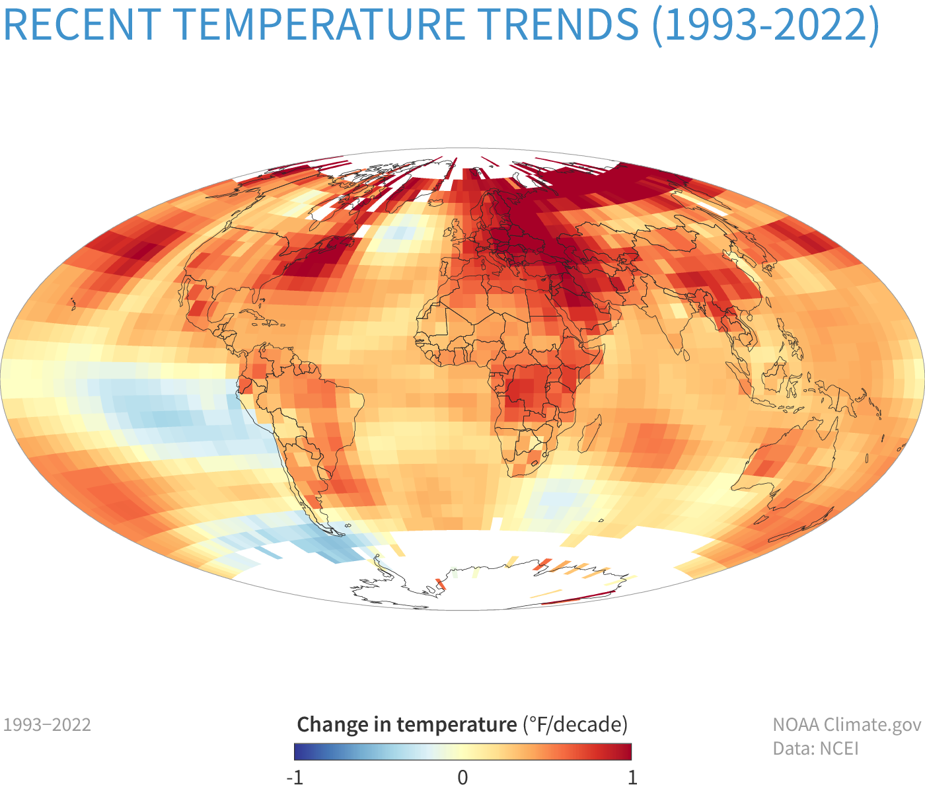
Recent trends in global climate
Learning objectives
Carbon cycle
Effects of increased CO₂ in the atmosphere
Emissions since the Industrial Revolution
Recent climate change trends
Human impact on climate patterns
The Arctic is warming fastest
Land warming faster than water
Reduced snow cover and sea ice
Intensification of rainfall
Changing of habitat ranges for plants and animals
Image copyright National Oceanic and Atmospheric Administration (NOAA). https://www.climate.gov/media/15022
Notes:
*Animated to highlight specific regions for first three points
Some very general trends in global climate:
The Arctic is warming faster than other locations on Earth.
Land is generally warming faster than water.
Snow cover, sea ice, and ice sheets are losing ice.

Slide 10
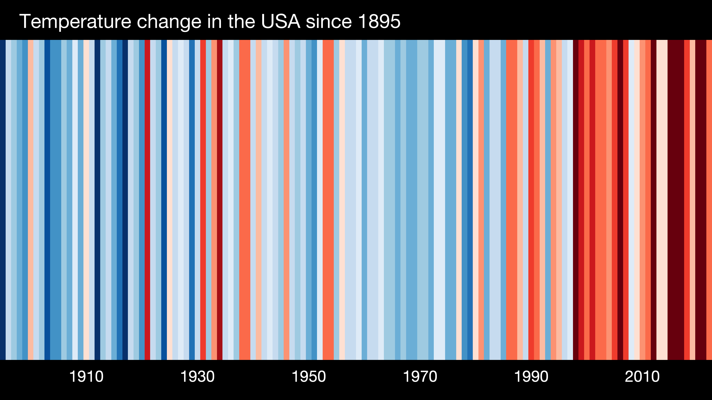
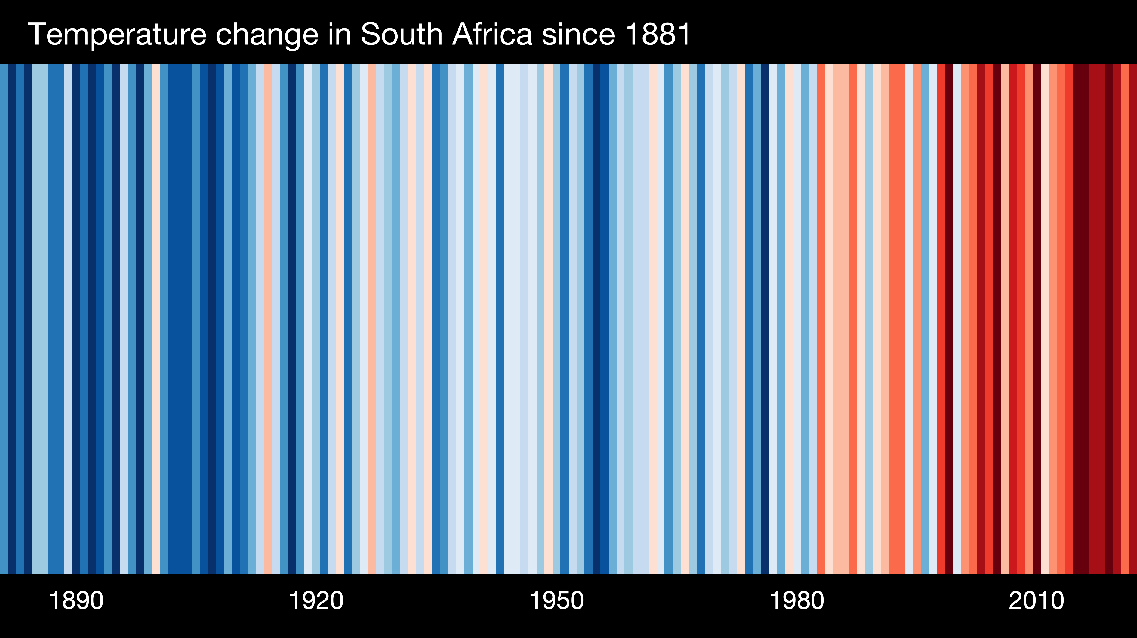
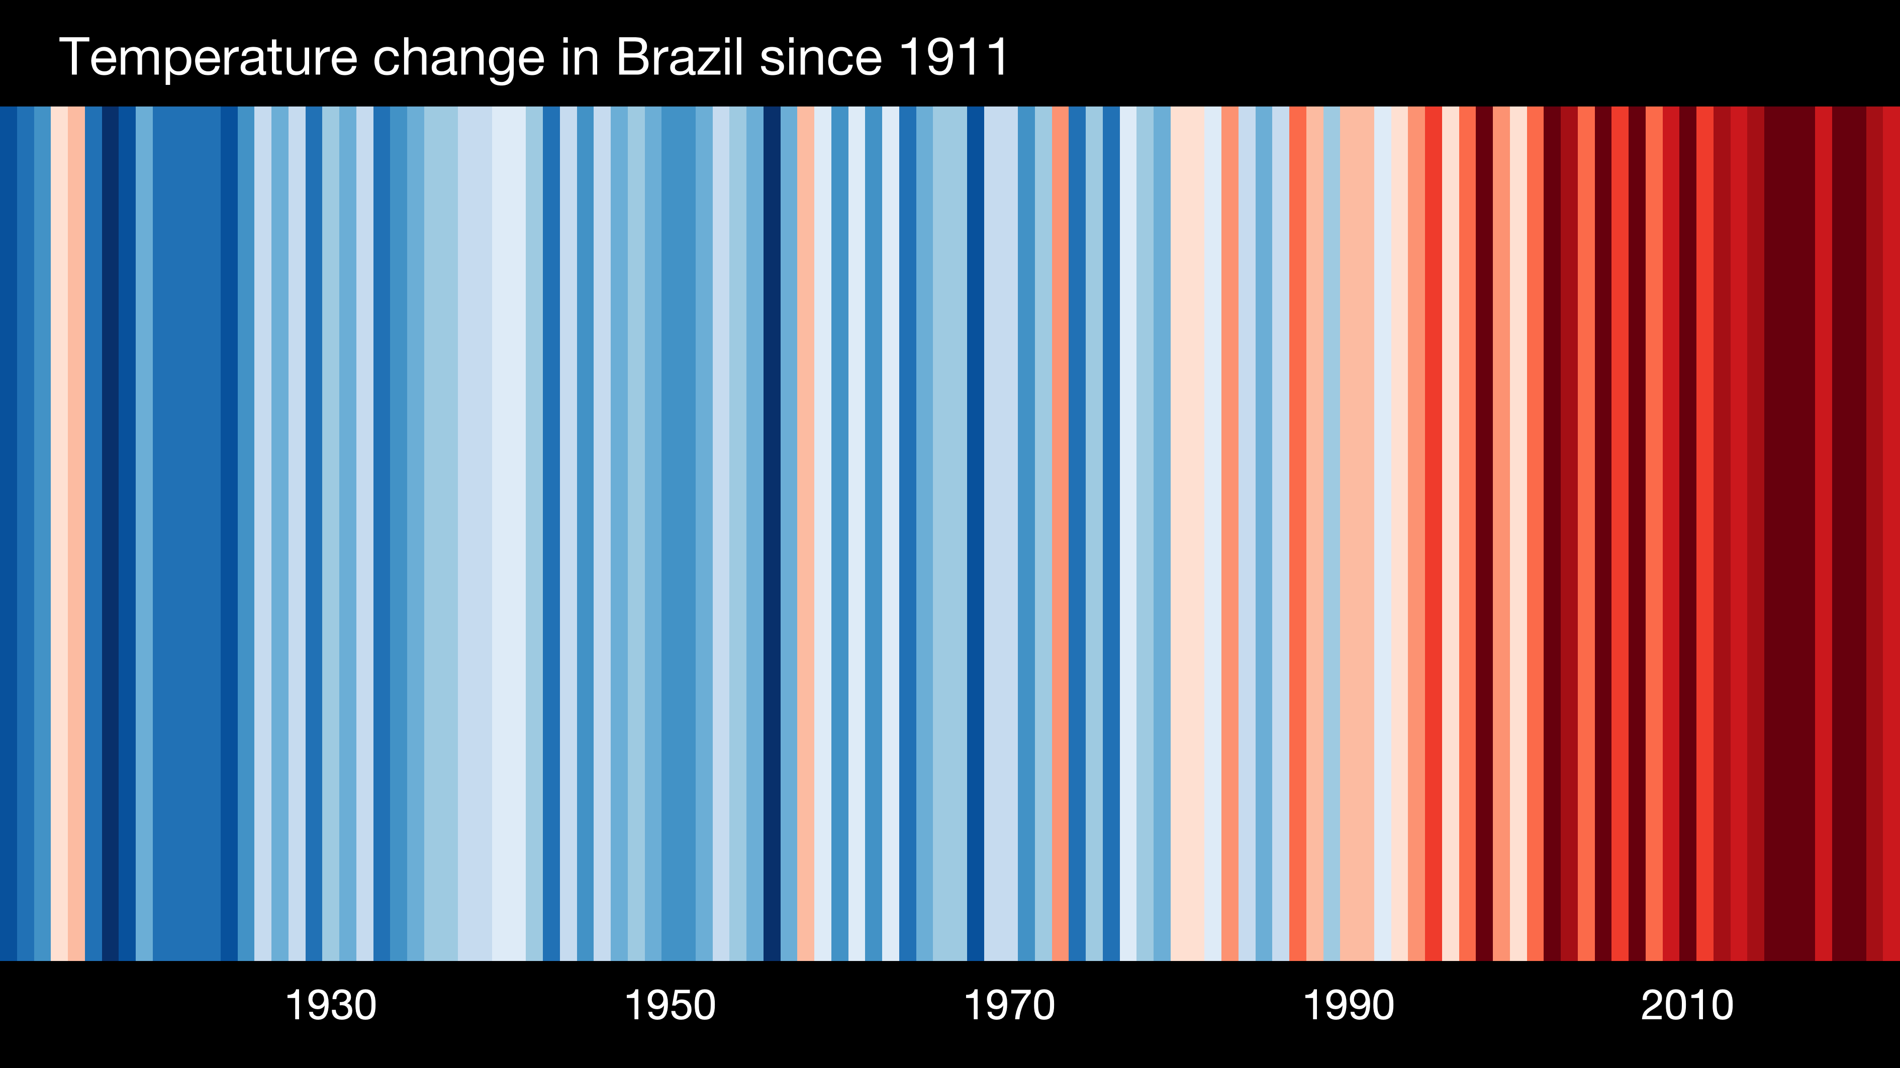
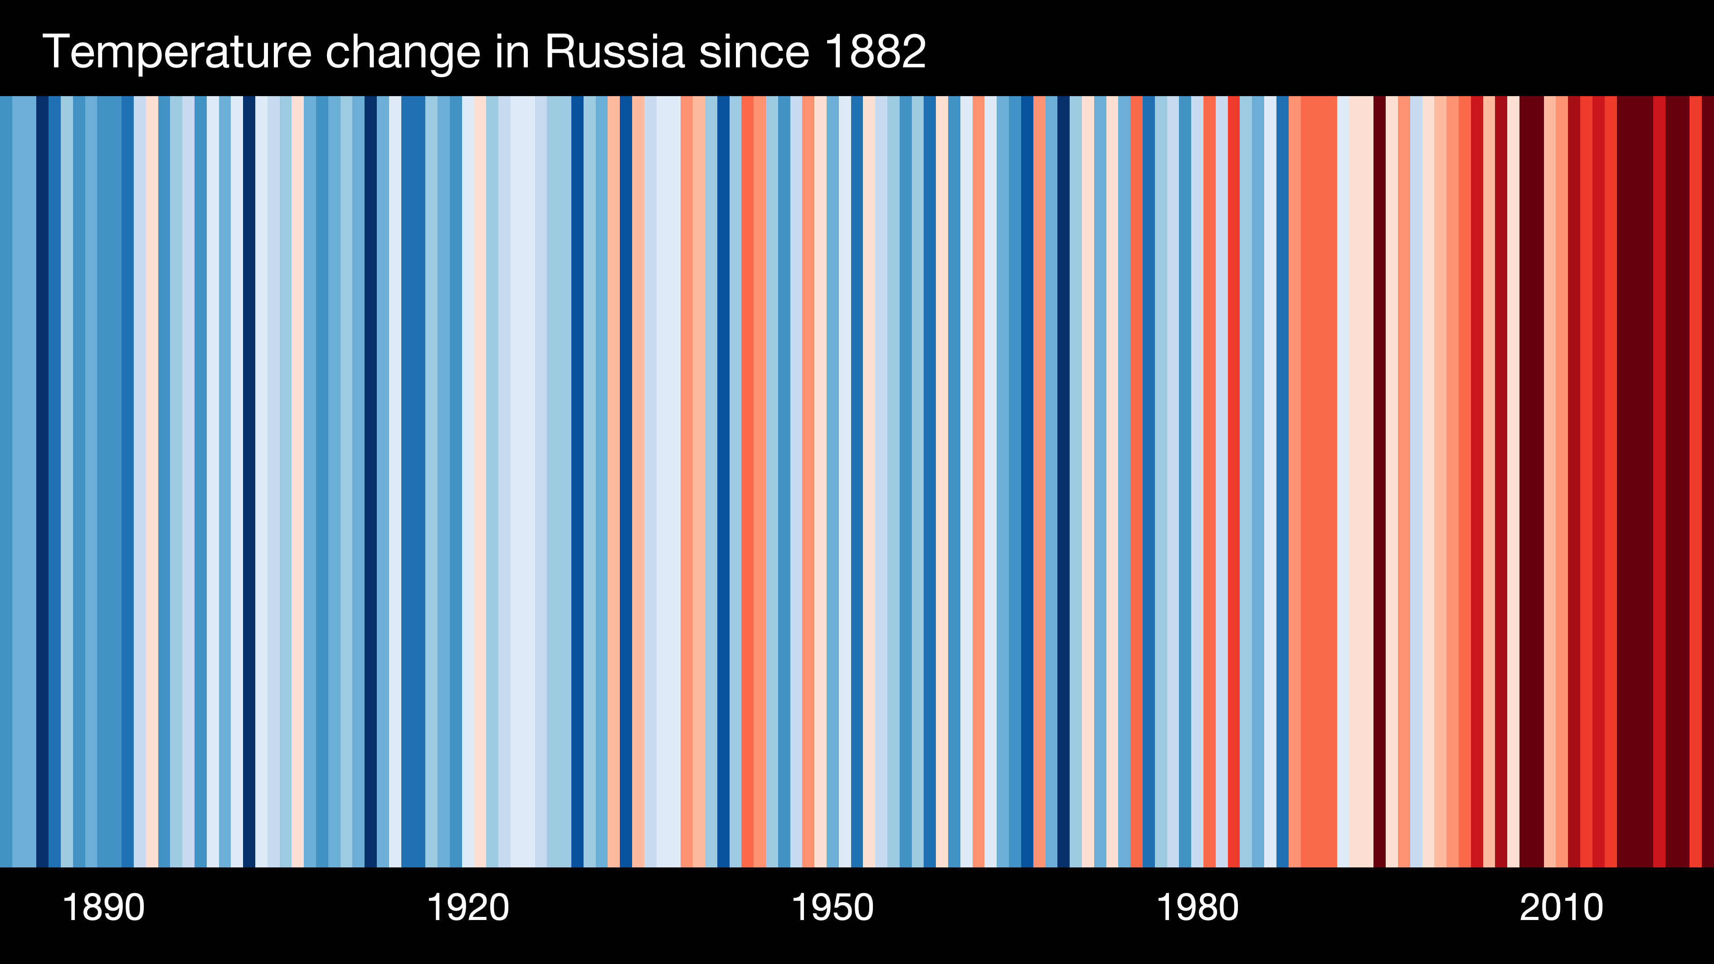
Recent trends in climate
Learning objectives
Carbon cycle
Effects of increased CO₂ in the atmosphere
Emissions since the Industrial Revolution
Recent climate change trends
Human impact on climate patterns
Image copyright University of Reading. https://www.showyourstripes.info/
Notes:
*Slide is animated to highlight specific regions – first Brazil and South Africa, then USA and Russia*
When we look more closely at the warming stripes for specific regions, we see a different trend than what we saw for the Earth as a whole.
Brazil and South Africa more closely follow the global pattern, whereas the USA and Russia have both experienced different patterns in when warming began and how severe it has become.

Slide 11
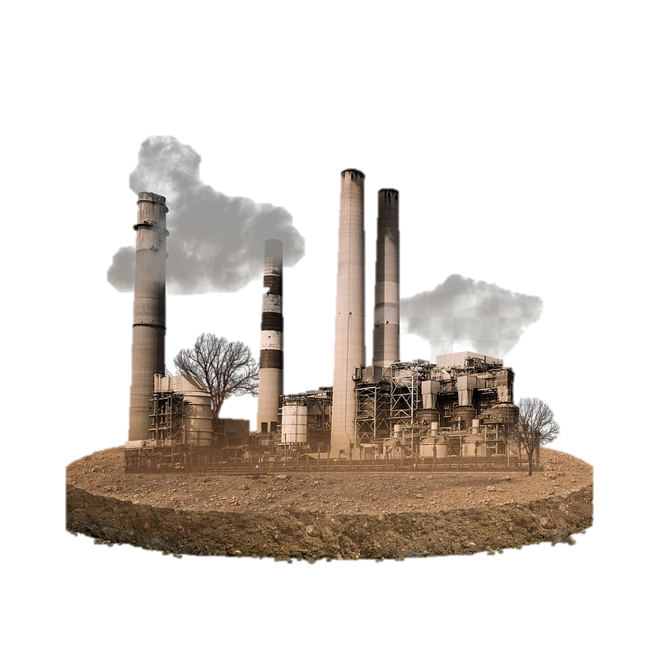

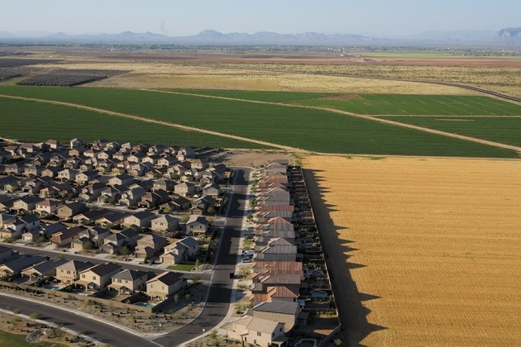
Human drivers of climate change
Learning objectives
Carbon cycle
Effects of increased CO₂ in the atmosphere
Emissions since the Industrial Revolution
Recent climate change trends
Human impact on climate patterns
Fossil fuel combustion releasing greenhouse gases (GHG)
Ozone*, a GHG, forms when pollution reacts with sunlight
Land cover changes, changing absorption and reflection of energy
Aerosols, such as dust, water, and condensed greenhouse gases, reflect and absorb energy
*The ozone layer occurs at a higher altitude in the atmosphere and does not significantly contribute to current global climate trends

Slide 12
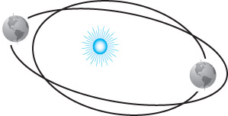
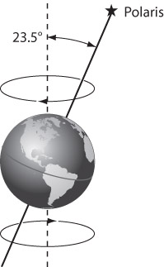
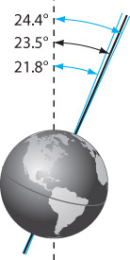
Natural drivers of climate change
Learning objectives
Carbon cycle
Effects of increased CO₂ in the atmosphere
Emissions since the Industrial Revolution
Recent climate change trends
Human impact on climate patterns
Volcanoes emitting greenhouses gases
Changes in insolation and sunspots
Changes in Earth’s orbital patterns

Slide 13
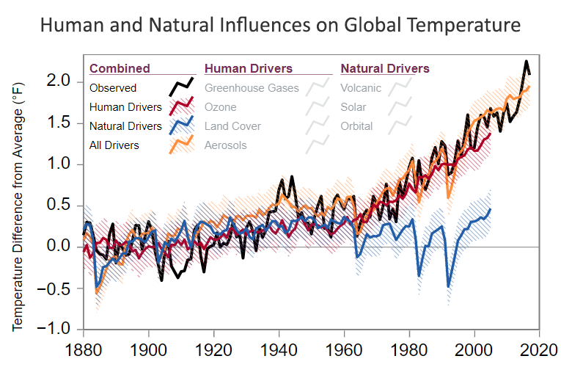
Current influences on global temperature
Learning objectives
Carbon cycle
Effects of increased CO₂ in the atmosphere
Emissions since the Industrial Revolution
Recent climate change trends
Human impact on climate patterns
Image copyright United States Environmental Protection Agency. https://www.epa.gov/climatechange-science/causes-climate-change
Notes:
*Animated to highlight modeled temperatures from only natural drivers, only human drivers, and human and natural drivers combined*
Comparing climate models to observed temperatures is one way we can identify the causes of the climate change the earth is experiencing.
We can look more closely at the causes of the increase in global temperatures since the Industrial Revolution as well. The blue line here represents natural temperature drivers, such as changes in how the Earth orbits around the sun, volcanic activity, and changes in insolation. If our global climate was only changed by these natural factors, the earth would have experienced a much more moderate temperature increase, less than 0.5°F by 2010.
If only humans were driving the increase in global temperatures, the earth would have about a 1.2°F increase in temperature.
When we combining both human and natural drivers, which is the yellow line, we can model temperatures that more closely resemble observed trends (black line) of an increase of global temperature around 2°F.

Slide 14
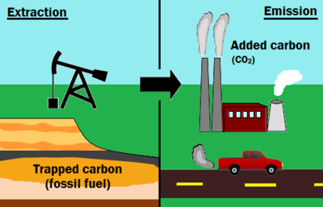
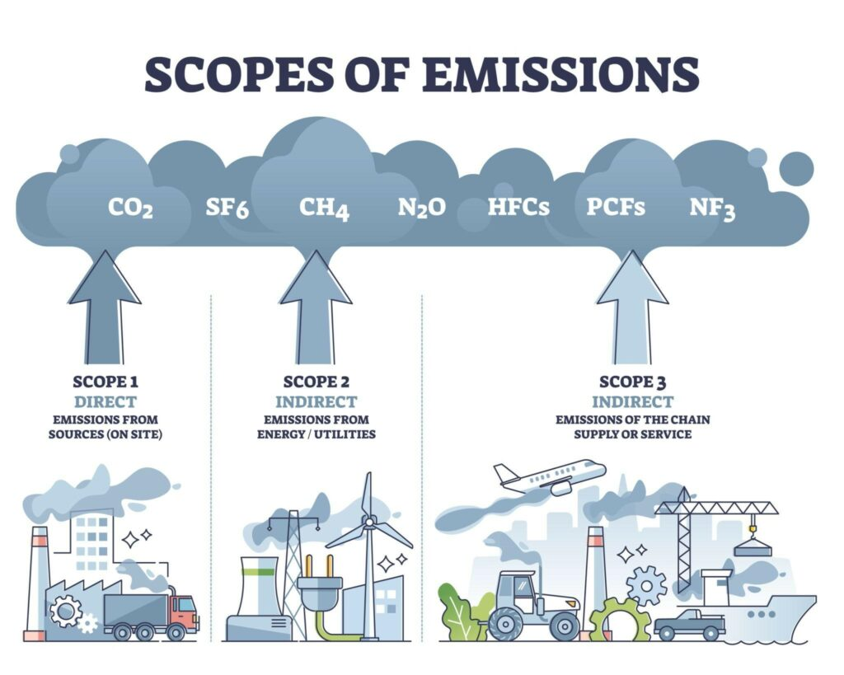
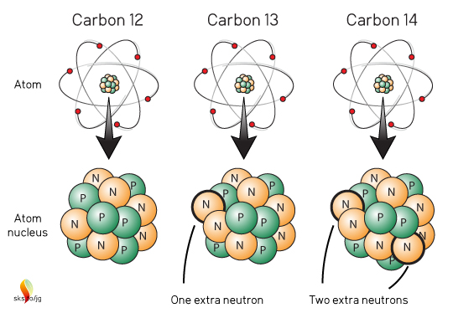
Human impact on climate: How do we know?
Learning objectives
Carbon cycle
Effects of increased CO₂ in the atmosphere
Emissions since the Industrial Revolution
Recent climate change trends
Human impact on climate patterns
Accounting
Comparing what is burned with what is emitted
Simple Chemistry
Combusting fossil fuels releases CO₂
Chemical Analysis
Old carbon from fossil fuels
Notes:
*Animated to show each line of evidence one by one*
How else can we tell that humans are affecting the increase in global temperatures?
We can use simple chemistry – we know that when we extract fossil fuel and combust it, CO2 will be released.
We can use general accounting – this is comparing what and how much fossil fuel is burned with how much CO2 is being emitted.
We can use chemical analysis to determine the types of carbon being emitted over time. Natural sources contain different isotopes of carbon than fossil fuels. When analyze carbon in our environment, we see that it overwhelmingly has the chemical symbol from fossil fuels. Likewise, this carbon is very old (no longer contains 12C).
Image credits:
Simple Chemistry - combustion: University of Calgary. https://energyeducation.ca/encyclopedia/Anthropogenic_carbon_emissions
Simple Chemistry – greenhouse effect: Ecosystems United. https://sendthewholebattalion.files.wordpress.com/2016/02/sunearthdiagram.jpg?w=525
Accounting: Corporate Finance Institute: https://cdn.corporatefinanceinstitute.com/assets/carbon-accounting-1024x819.jpg
Chemical Analysis: Skeptical Science. https://skepticalscience.com//pics/Carbon12_13_14.jpg

Slide 15
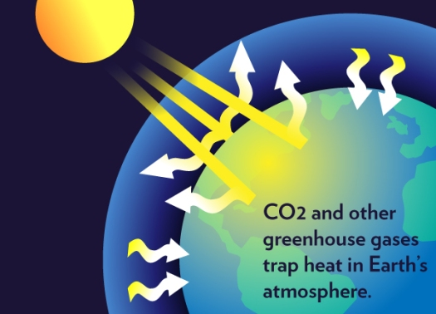
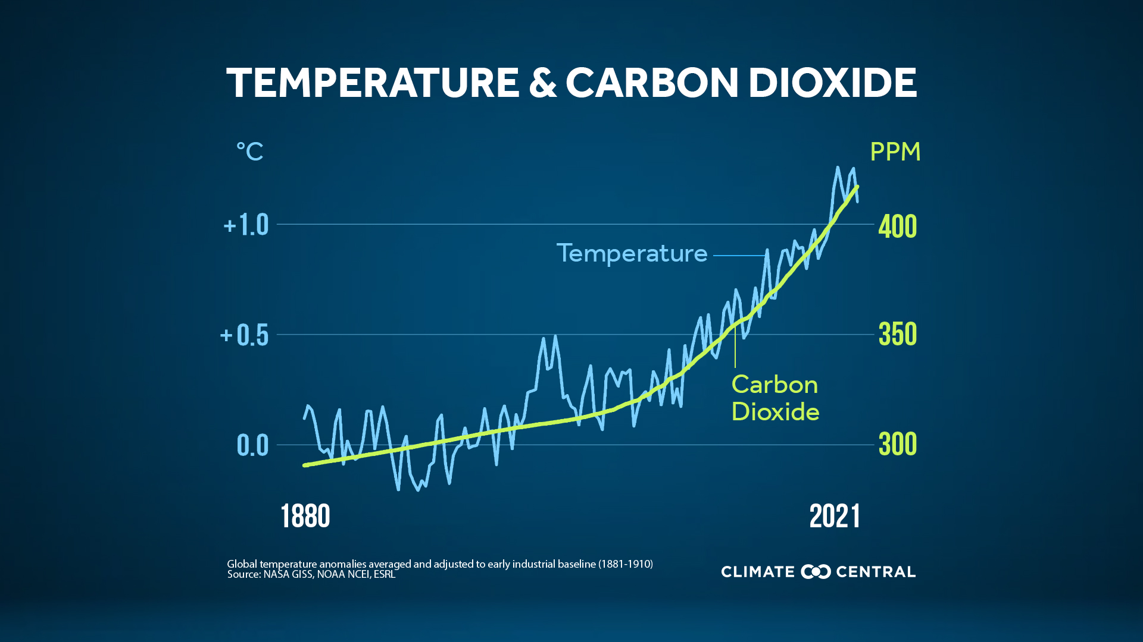
Human impact on climate: How do we know?
Learning objectives
Carbon cycle
Effects of increased CO₂ in the atmosphere
Emissions since the Industrial Revolution
Recent climate change trends
Human impact on climate patterns
Physics
CO₂ contributes to greenhouse effect
Monitoring
Keeping track of environmental conditions + analysis
Notes:
*Animated to show each line of evidence one by one*
How else can we tell that humans are affecting the increase in global temperatures? (continued)
Physics and thermal dynamics helps us understand that greenhouse gases, like CO2, absorb heat and contribute to the greenhouse effect.
We can also monitor and compare environmental conditions, such as temperature and atmospheric CO2 concentration.
How do we know this is human-caused?
How are humans impacting climate via changes we make?
Image credits:
Physics: Ecosystems United. https://sendthewholebattalion.files.wordpress.com/2016/02/sunearthdiagram.jpg?w=525
Monitoring: Climate Central. https://images.ctfassets.net/cxgxgstp8r5d/cm-892-graphic-annual-co2-peak-and-temperature/ecb9597fe288fdd22584f8cd5cc4c787/2022GHG_CO2AndTemp_en_title_lg.jpg

Slide 16
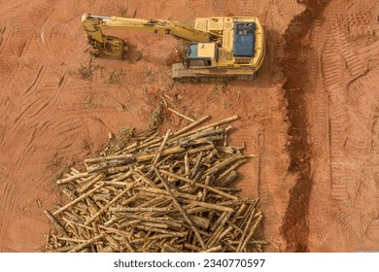
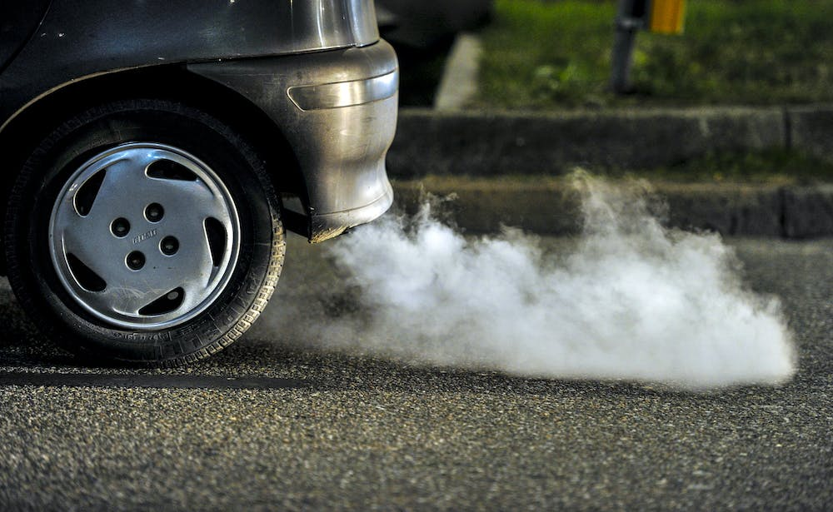
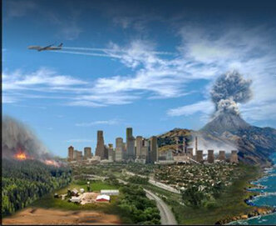
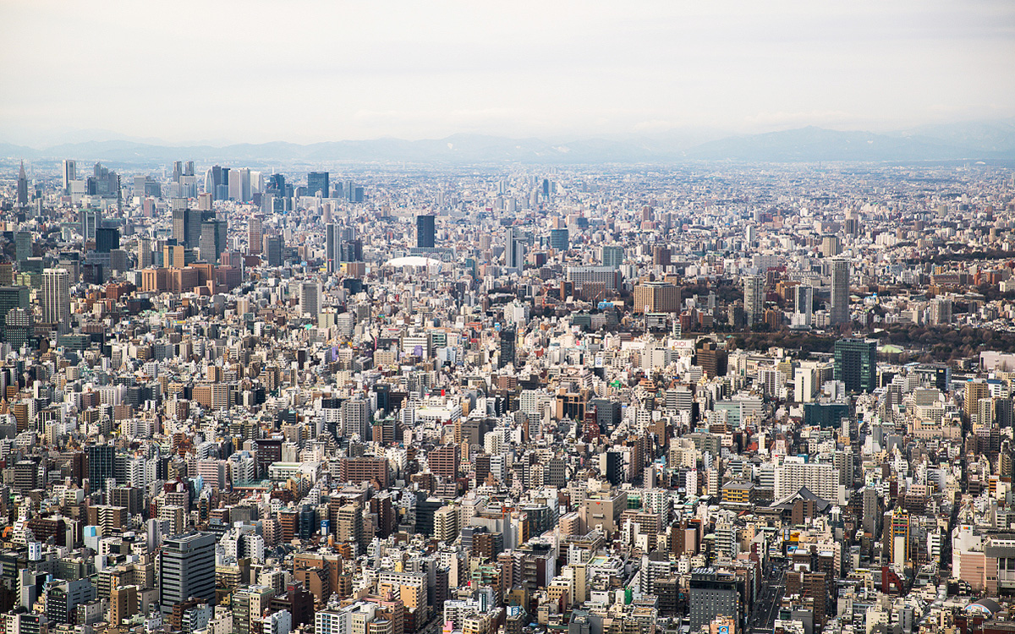
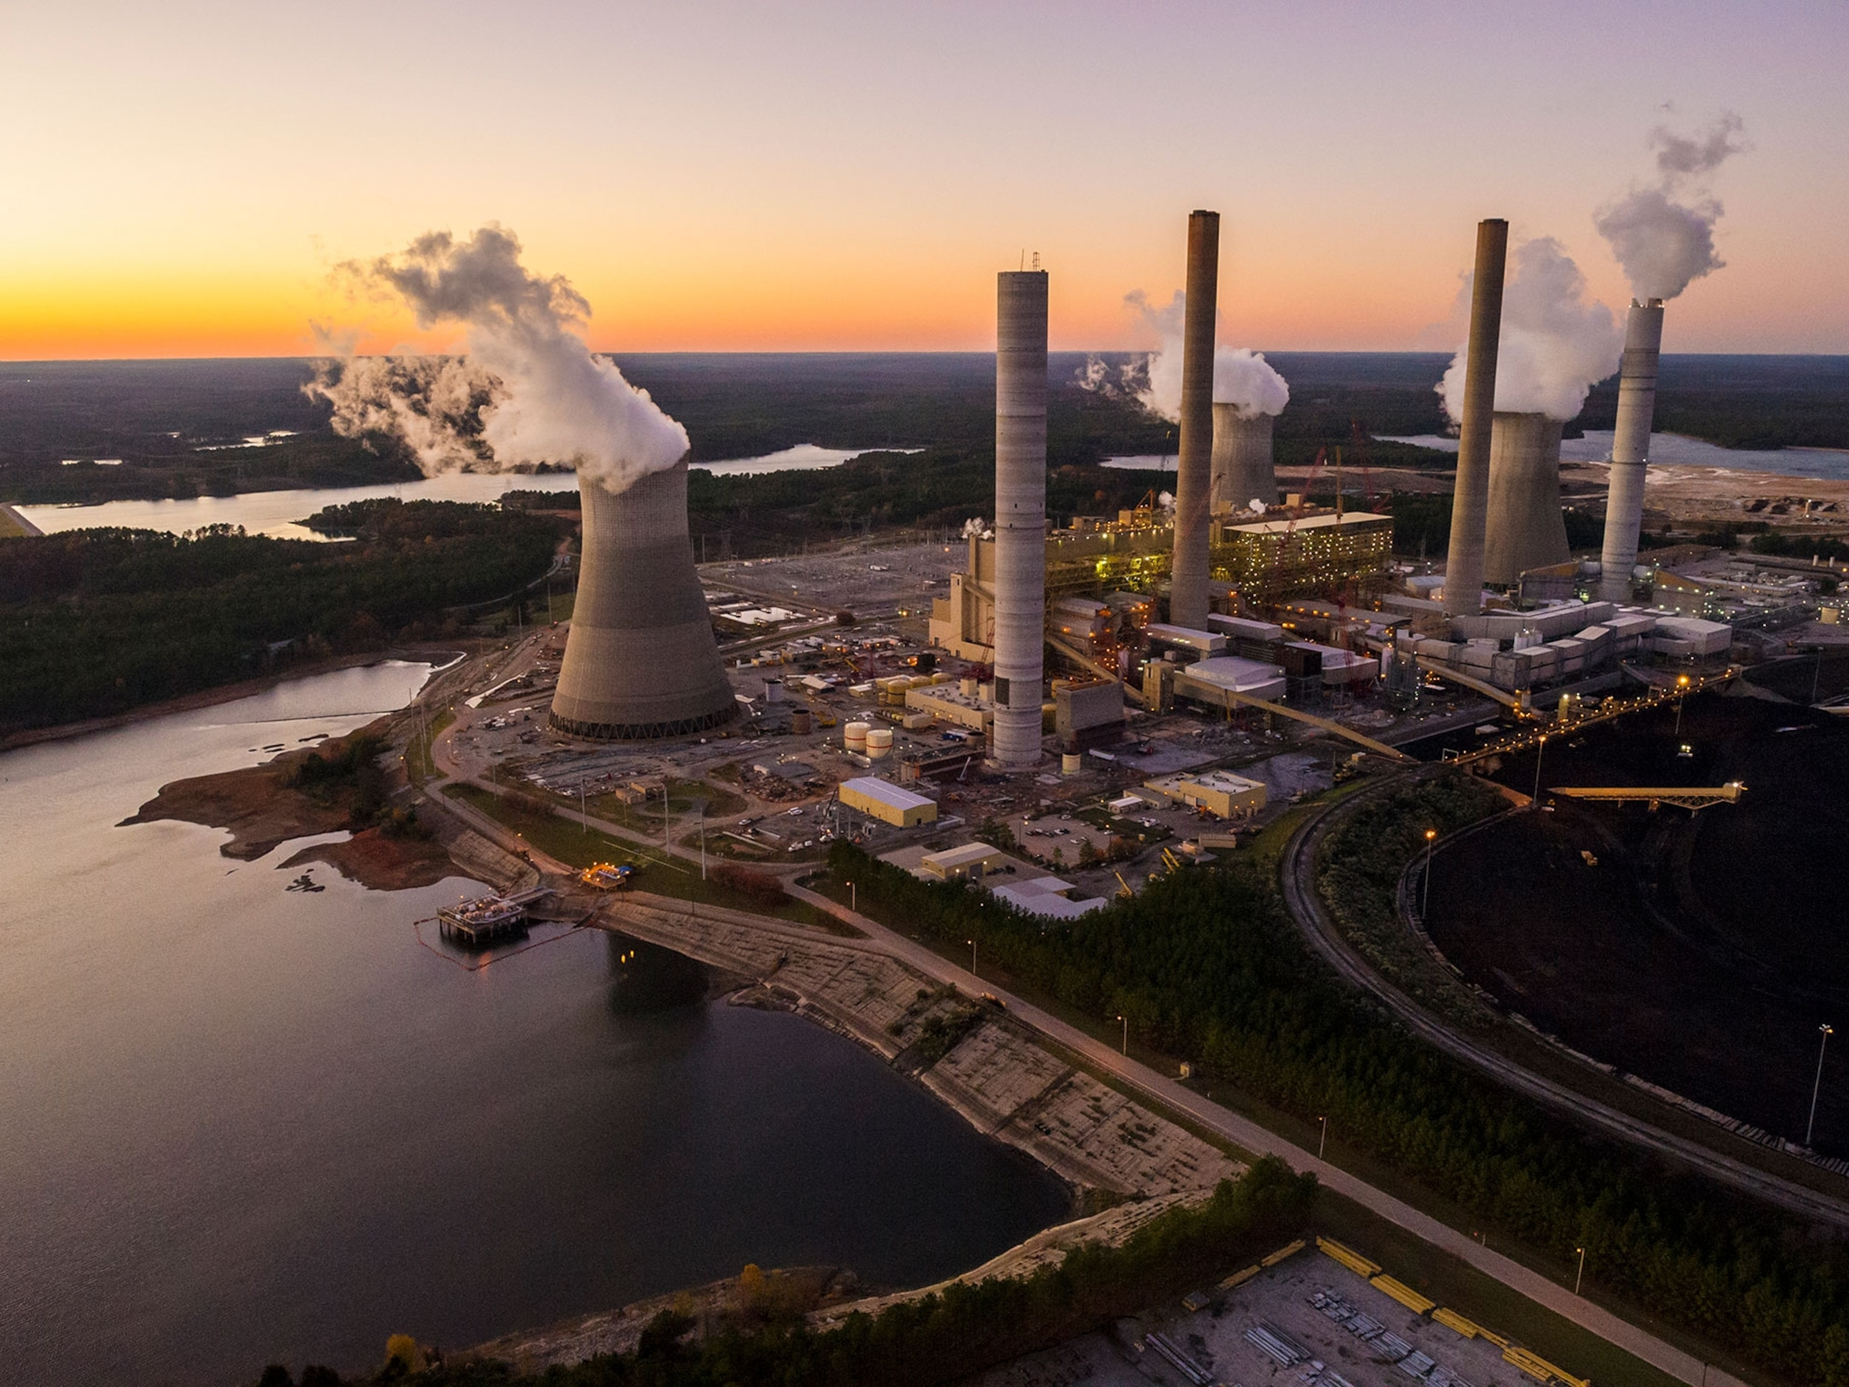
Human impact on climate
Learning objectives
Carbon cycle
Effects of increased CO₂ in the atmosphere
Emissions since the Industrial Revolution
Recent climate change trends
Human impact on climate patterns
Cause:
Changes in land use, such as urbanization and agriculture
Cause:
Fossil fuel combustion releasing greenhouse gases
Cause:
Aerosols and pollution from urban areas, transportation, industry, agriculture, and burning biomass
Effect:
Removal of GHG sinks, drastically change how energy moves through Earth’s systems
Effect:
Increase greenhouse effect, increase reflection of insolation, ozone depletion, form clouds, acid deposition, health effects, and reduced visibility
Effect:
Increased greenhouse effect and global warming
Notes:
*Animated to for each factor to pop up one by one.*
Humans have contributed to changes in global warming and in local climates. These changes have a few different causes:
We have drastically changed the Earth’s landscapes. We have cleared land that was once forested, built cities, planted miles and miles of agriculture, etc. This results in reducing our greenhouse gas sinks, such as major forested areas. This also changes how energy moves through and is stored in our Earth’s systems. This means, for example, that an area that previously might have been cool might now be warm because it no longer has the surface cover that would reflect insolation.
As we know, we use fossil fuels to power our cars, electricity, industry, and so forth. This combustion results in greenhouse gases being released. As we release greenhouse gases, we increase the greenhouse effect. This also combines with our changes in land use. We are adding more greenhouse gases, but reducing the amount of carbon storage options.
We also have aerosols (small solid or liquid particles suspended in the atmosphere) from urban areas, transportation, industry, agriculture, and burning biomass. This results in an increased greenhouse effect, increase in clouds and reflection of insolation (causing changes in energy at the surface and thus changes in local climates), ozone depletion, acid rain and deposition, human health effects such as respiratory ailments, and reduced visibility.
Image credits:
Aerosols: NOAA. https://www.climate.gov/news-features/feed/state-science-factsheet-aerosols-and-climate-updated

Slide 17
How have humans affected climate and climate patterns in recent years?
Learning objectives
Carbon cycle
Effects of increased CO₂ in the atmosphere
Emissions since the Industrial Revolution
Recent climate change trends
Human impact on climate patterns
Carbon moves throughout the Earth’s systems and is naturally stored in rocks and soils, the oceans, buried deposits (fossil fuels), living things, and the atmosphere
Increasing CO₂ in our atmosphere causes an increase in the greenhouse effect and therefore an increase in global temperature
As a whole, the Earth is experiencing a warming trend
On a smaller scale, climate changes more independently based on local climate factors
We can connect human activity to warming through chemistry and chemical analysis, accounting, and physics
Some of the ways that humans have affected climate is through changes in land use, fossil fuel combustion, and production of aerosols and pollution

Slide 18
Discussion Prompts
How would concentrations of atmospheric greenhouse gases change if there were more:
Volcanic activity?
Weathering?
Burning of fossil fuels?
What is the connection between CO2 emissions and atmospheric CO2 concentrations?
What are the general trends in global warming?
What evidence indicates that humans are affecting the climate?
How do scientists know that some drivers of change are natural and others are human in origin?

